Slide 1

Understanding Cloud Storage Mechanisms
CSA1521- Cloud Computing and Big Data Analytics
Guided by
Dr. Santhiya Lakshmi K
Done by
Beffy A Shanika(192511387)

Slide 2
Introduction
What is Cloud Storage?
Cloud storage is a service that stores data on remote servers instead of a local computer.
Data can be accessed anytime using the Internet.
Managed by cloud service providers.
Provides secure and scalable storage.

Slide 3
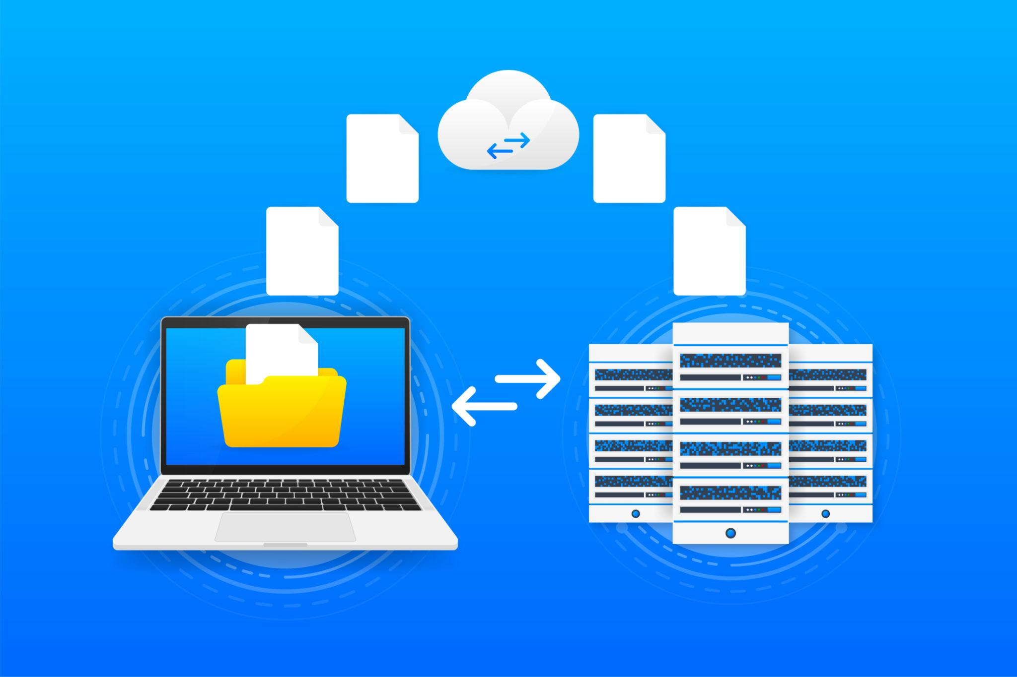
How Cloud Storage Works
Working Process
User uploads a file.
File travels through the Internet.
Cloud provider stores it in data centers.
Data is replicated for backup.
User can access it from any device.

Slide 4
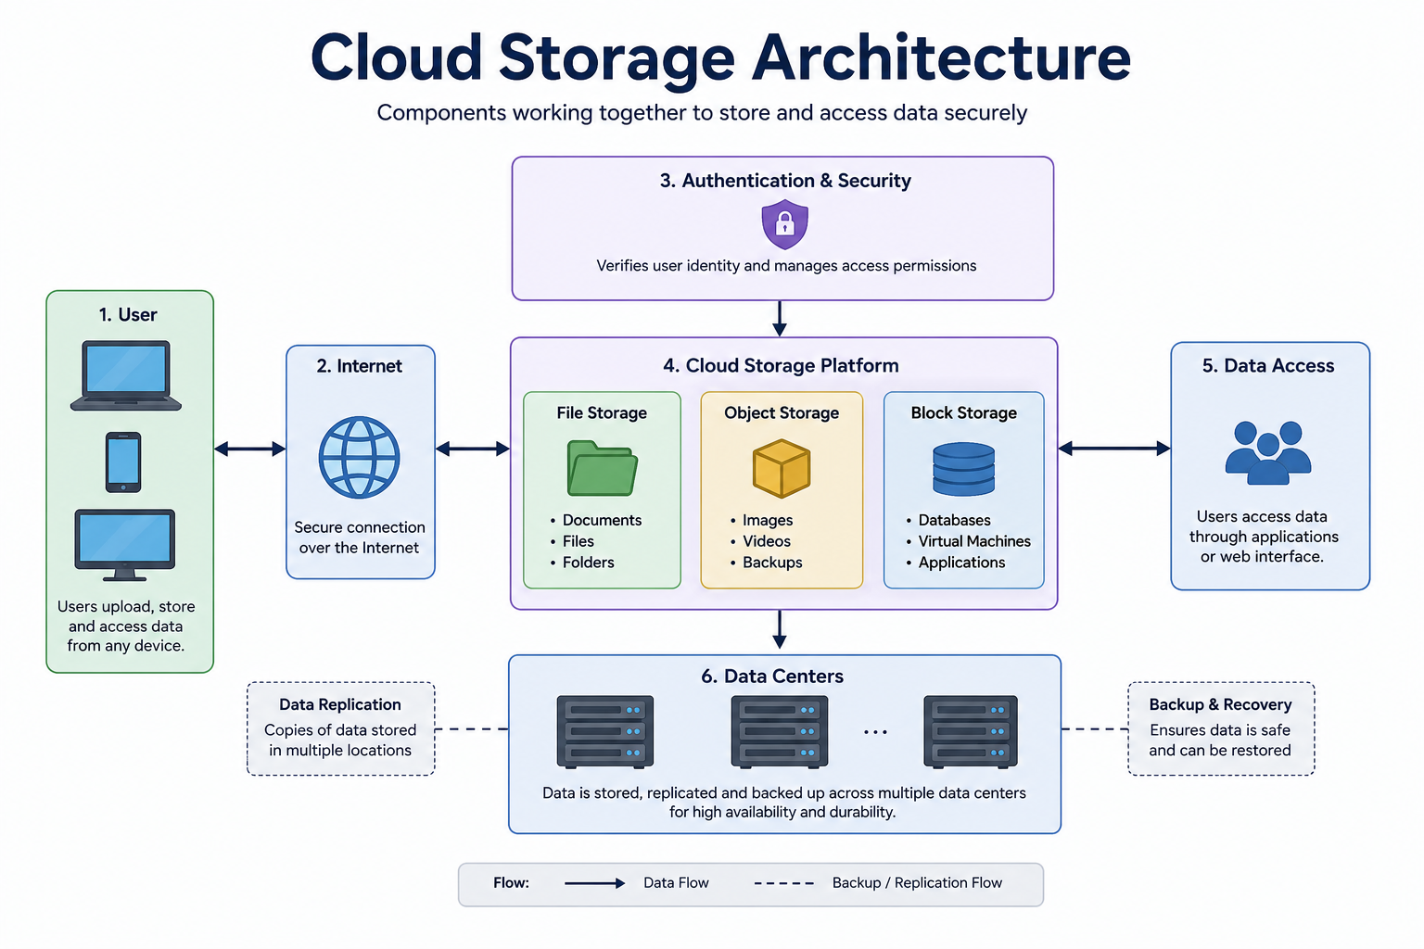

Slide 5
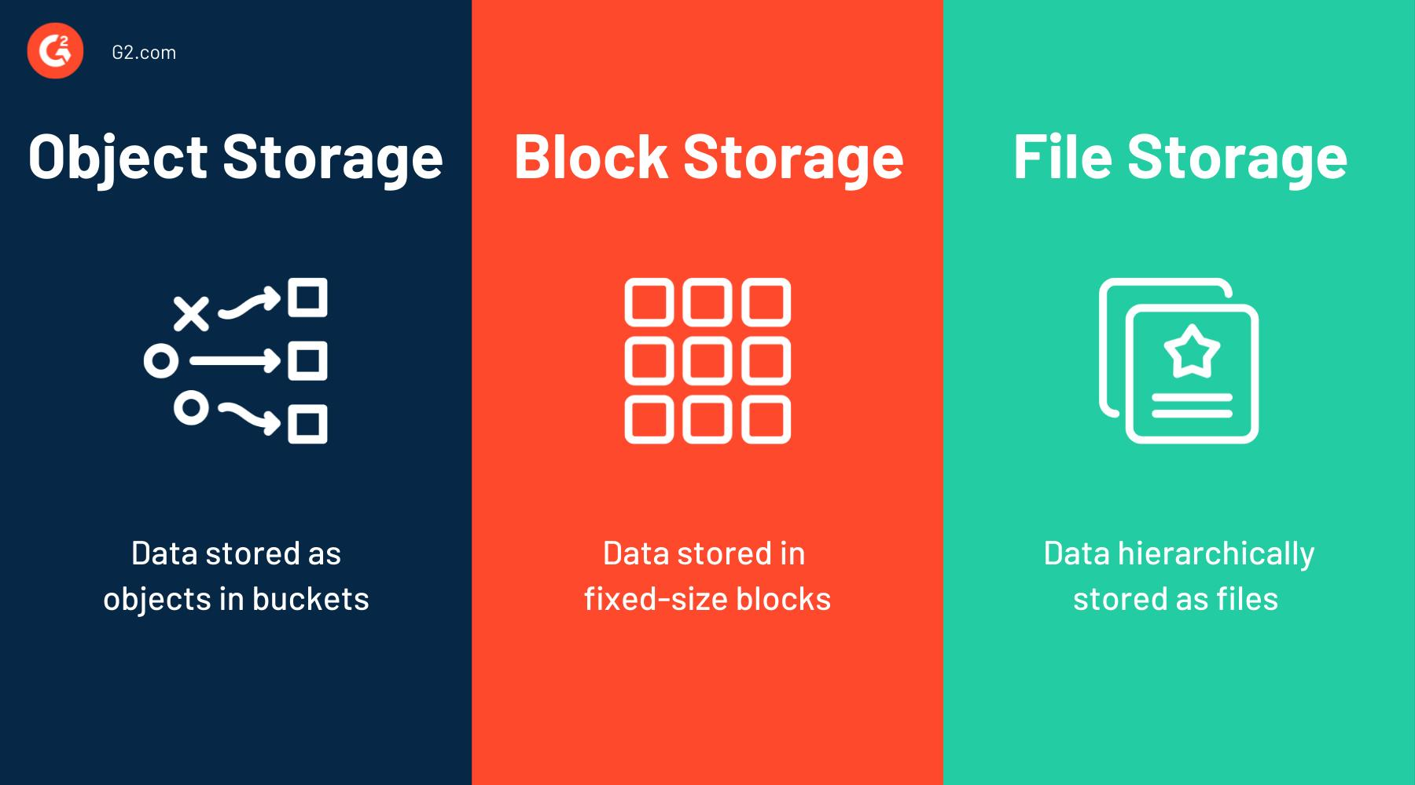
Types of Cloud Storage
1. Object Storage
Stores photos, videos, backups, and documents.
Highly scalable.
2. File Storage
Organizes files in folders.
Suitable for shared files.
3. Block Storage
Stores data in blocks.
Used for databases and virtual machines.

Slide 6
Practical Example
Google Drive:
How it Works
User uploads a file.
File is stored in Google's cloud servers.
Data is backed up automatically.
User accesses the file from any device.
Features
15 GB free storage
File sharing
Real-time collaboration
Automatic synchronization

Slide 7
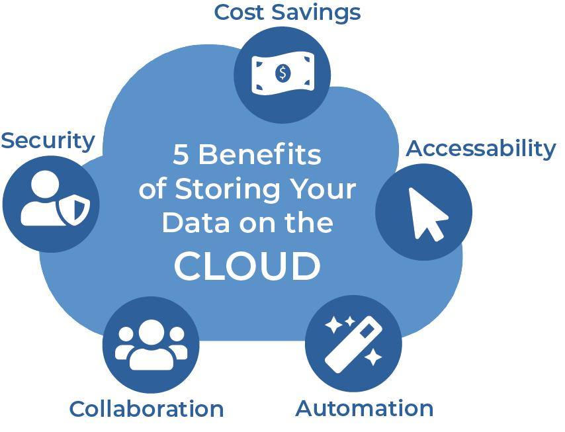
Advantages of Cloud Storage
Easy access from anywhere
Automatic backup
High security
Cost-effective
Scalable storage
File sharing
Disaster recovery
Reduced hardware maintenance

Slide 8

Application
Applications in Different Industries:
Education -Online learning materials
Healthcare -Patient records
Banking -Secure document storage
Business -Team collaboration
Media -Photo and video storage
Government -Digital records

Slide 9
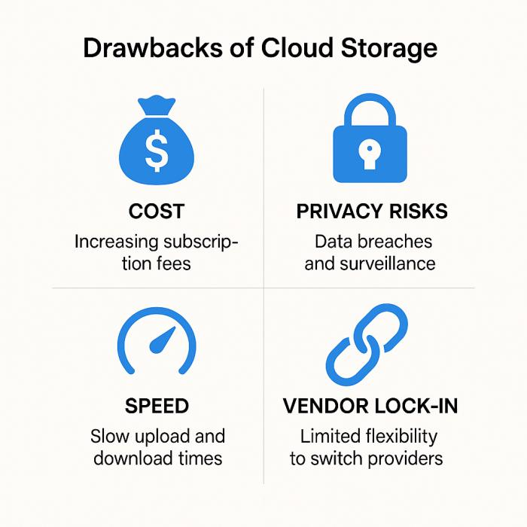
Challenges
Requires Internet connection
Security and privacy concerns
Storage subscription costs
Data transfer speed depends on network
Service outages may affect accessibility

Slide 10
Conclusion
Cloud storage provides secure and reliable online data storage.
It enables access from anywhere using the Internet. It supports collaboration, backup, and disaster recovery.
Widely used in education, healthcare, banking, and business.
Cloud storage is an essential technology in modern cloud computing.

Slide 11
Reference
Zeng, W., Zhao, Y., Ou, K., & Song, W. (2009, November). Research on cloud storage architecture and key technologies. In Proceedings of the 2nd International Conference on Interaction Sciences: Information Technology, Culture and Human (pp. 1044-1048).
Connor, D., Corrigan, P. H., Bagley, J. E., & NOW, S. S. (2011). Cloud storage: Adoption, practice and deployment. An Outlook Report from Storage Strategies NOW, 11-42.
Tahir, A., Chen, F., Khan, H. U., Ming, Z., Ahmad, A., Nazir, S., & Shafiq, M. (2020). A systematic review on cloud storage mechanisms concerning e-healthcare systems. Sensors, 20(18), 5392.
Zhang, Y., Xu, C., & Shen, X. S. (2020). Data security in cloud storage (pp. 1-171). Berlin/Heidelberg, Germany: Springer.
Liu, M., Pan, L., & Liu, S. (2023). Cost optimization for cloud storage from user perspectives: Recent advances, taxonomy, and survey. ACM Computing Surveys, 55(13s), 1-37.

Slide 12
Thank You!!

